Slide 1
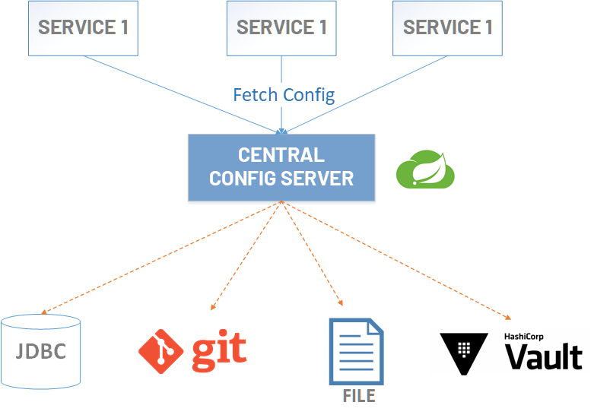

Config Server with GIT backend
www.jmaster.io/course/microservices-with-spring-cloud

Slide 2
References
https://cloud.spring.io/spring-cloud-config/reference/html/

